Slide 1
Chapter 9: Transport Layer
CCNA Routing and Switching
Introduction to Networks v6.0
Notes:
Cisco Networking Academy Program
Introduction to Networks v6.0
Chapter 9: Transport Layer

Slide 2
Chapter 9 - Sections & Objectives
9.1 Transport Layer Protocols
Explain how transport layer protocols and services support communications across data networks.
Explain the purpose of the transport layer in managing the transportation of data in end-to-end communication.
Explain characteristics of the TCP and UDP protocols, including port numbers and their uses.
9.2 TCP and UDP
Compare the operations of transport layer protocols in supporting end-to-end communication.
Explain how TCP session establishment and termination processes facilitate reliable communication.
Explain how TCP protocol data units are transmitted and acknowledged to guarantee delivery.
Describe the UDP client processes to establish communication with a server.
Determine whether high-reliability TCP transmissions, or non-guaranteed UDP transmissions, are best suited for common applications.
Notes:
2
Cisco Networking Academy Program
Introduction to Networks v6.0
Chapter 9: Transport Layer

Slide 3
9.1 Transport Layer Protocols
Notes:
9 – Transport Layer
9.1 – Transport Layer Protocols

Slide 4
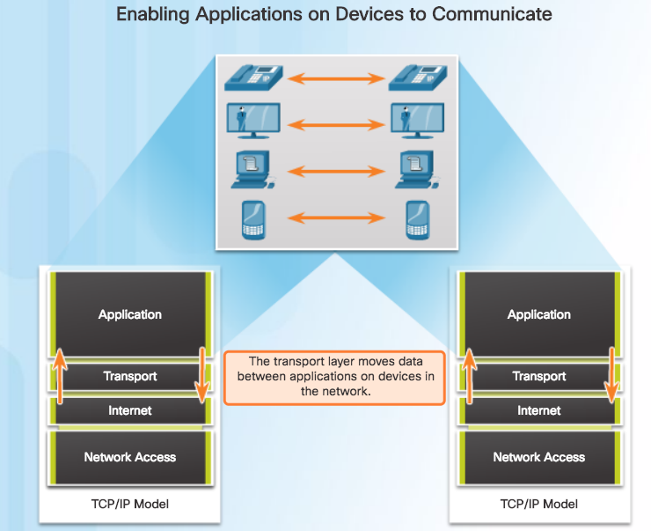
Transportation of Data Role of the Transport Layer
Responsible for establishing a temporary communication session between two applications and delivering data between them.
Link between the application layer and the lower layers that are responsible for network transmission.
Notes:
9.1 – Transport Layer Protocols
9.1.1 – Transportation of Data
9.1.1.1 – Role of the Transport Layer

Slide 5
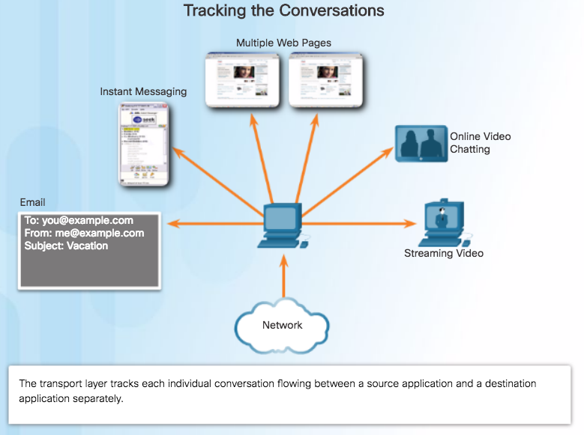
Transportation of Data Transport Layer Responsibilities
Tracking the Conversation - Tracks each individual conversation flowing between a source and a destination application.
Segmentation - Divides the data into segments that are easier to manage and transport. Header used for reassembly is used for tracking.
Identifying the Application - Ensures that even with multiple applications running on a device, all applications receive the correct data via port numbers.
Notes:
9.1 – Transport Layer Protocols
9.1.1 – Transportation of Data
9.1.1.2 – Transport Layer Responsibilities

Slide 6
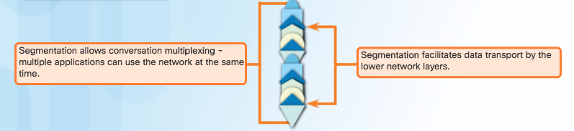
Transportation of Data Conversation Multiplexing
Segmenting the data into smaller chunks enables many different communications to be multiplexed on the same network.
Notes:
9.1 – Transport Layer Protocols
9.1.1 – Transportation of Data
9.1.1.3 – Conversation Multiplexing

Slide 7
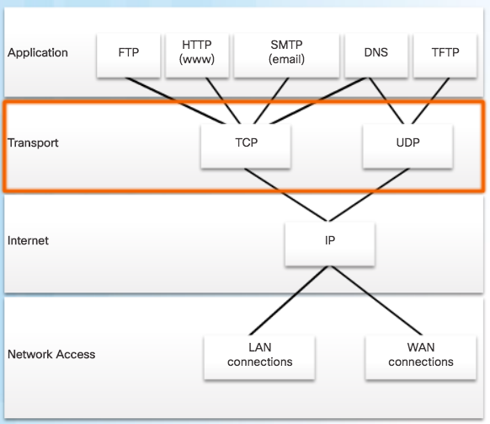
Transportation of Data Transport Layer Reliability
TCP/IP provides two transport layer protocols:
Transmission Control Protocol (TCP)
Considered reliable which ensures that all of the data arrives at the destination.
Additional fields needed in header which increases size and delay.
User Datagram Protocol (UDP)
Does not provide for reliability.
Fewer fields and is faster than TCP.
Notes:
9.1 – Transport Layer Protocols
9.1.1 – Transportation of Data
9.1.1.4 – Transport Layer Reliability

Slide 8
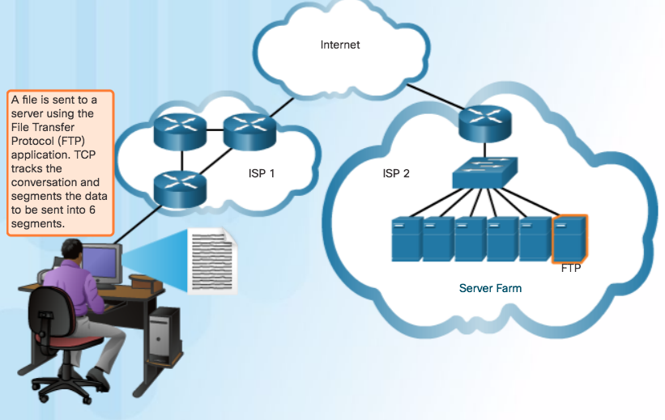
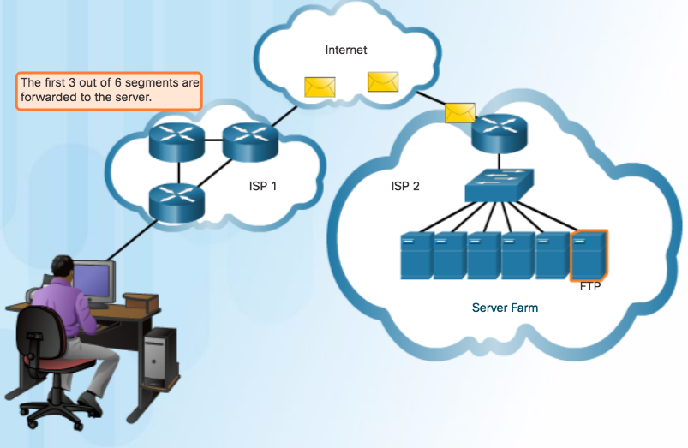
Transportation of Data TCP
TCP transport is similar to sending tracked packages. If a shipping order is broken up into several packages, a customer can check online to see the order of the delivery.
Notes:
9.1 – Transport Layer Protocols
9.1.1 – Transportation of Data
9.1.1.5 – TCP

Slide 9
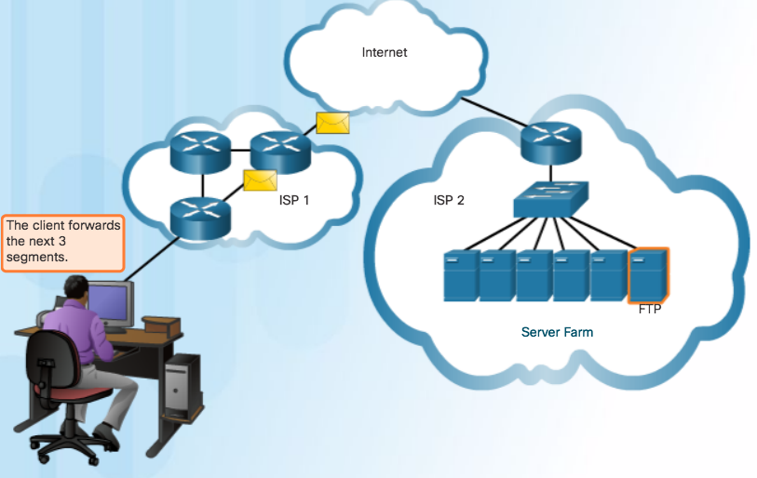
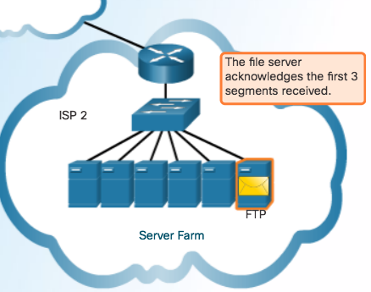
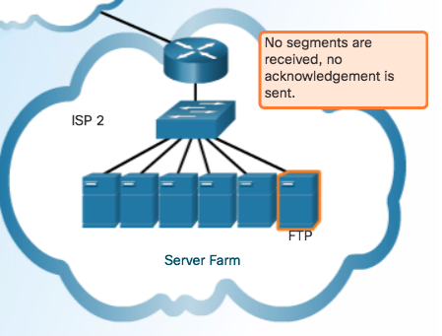
Transportation of Data TCP (Cont.)
Notes:
9.1 – Transport Layer Protocols
9.1.1 – Transportation of Data
9.1.1.5 – TCP

Slide 10
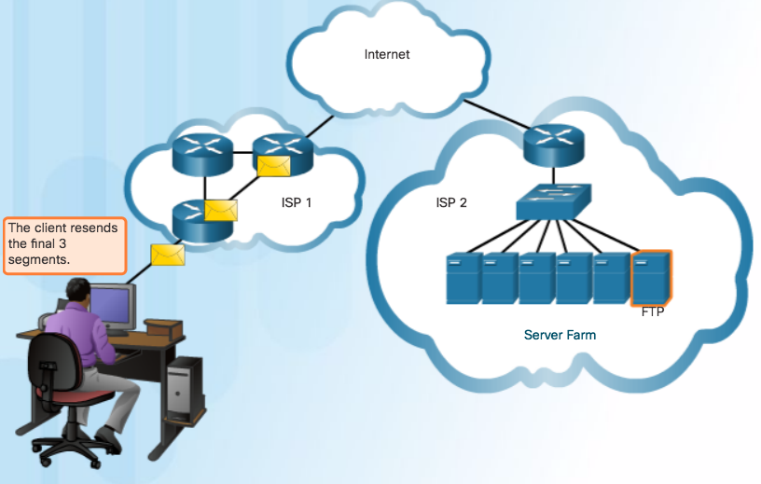
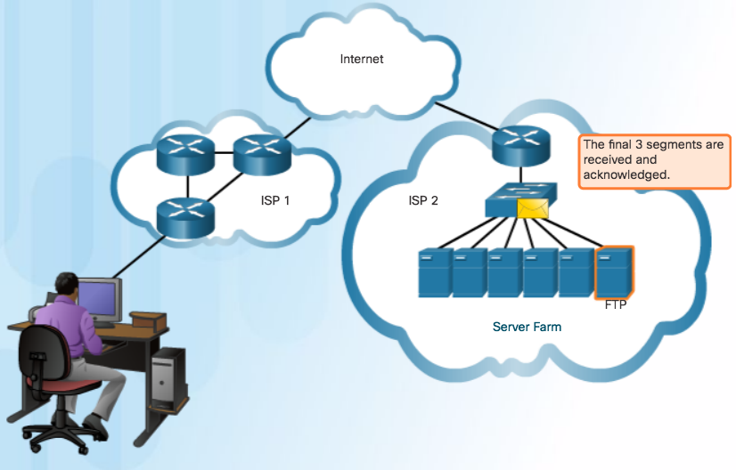
Transportation of Data TCP (Cont.)
TCP Three Responsibilities:
Numbering and tracking data segments
Acknowledging received data
Retransmitting any unacknowledged data after a certain period of time
Notes:
9.1 – Transport Layer Protocols
9.1.1 – Transportation of Data
9.1.1.5 – TCP

Slide 11
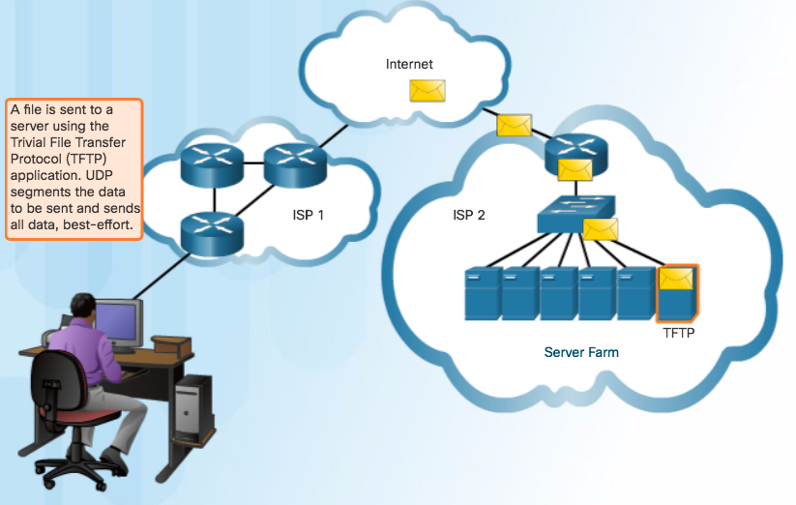
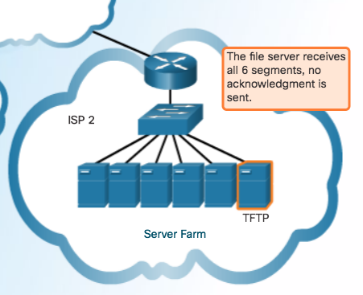
Transportation of Data UDP
Use UDP for less overhead and to reduce possible delays.
Best-effort delivery (unreliable)
No acknowledgment
Similar to a non-registered letter
Notes:
9.1 – Transport Layer Protocols
9.1.1 – Transportation of Data
9.1.1.6 – UDP

Slide 12
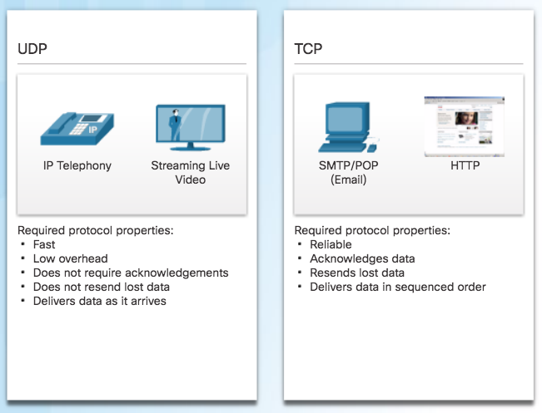
Transportation of Data The Right Transport Layer Protocol for the Right Application
TCP - databases, web browsers, and email clients require that all data that is sent arrives at the destination in its original condition.
UDP - if one or two segments of a live video stream fail to arrive, if disruption in the stream, may not be noticeable to the user.
Notes:
9.1 – Transport Layer Protocols
9.1.1 – Transportation of Data
9.1.1.7 – The Right Transport Layer Protocol for the Right Application

Slide 13
TCP and UDP Overview TCP Features
Establishing a Session
Connection-oriented protocol
Ensures the application is ready to receive the data
Negotiate the amount of traffic that can be forwarded at a given time
Reliable Delivery
Ensuring that each segment that the source sends arrives at the destination
Same-Order Delivery
Numbering & Sequencing the segments guarantees reassembly into the proper order
Flow Control
Regulate the amount of data the source transmits
Notes:
9.1 – Transport Layer Protocols
9.1.2 – TCP and UDP Overview
9.1.2.1 – TCP Features

Slide 14
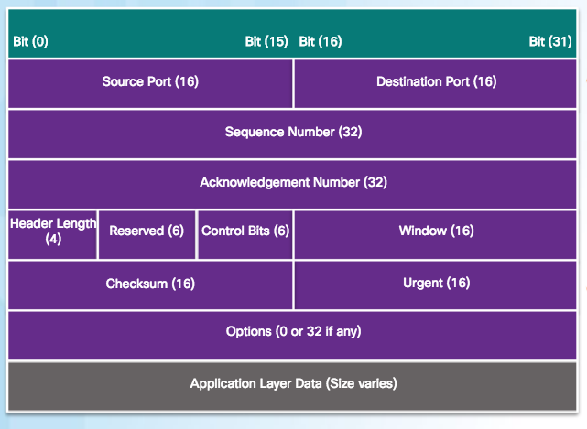
TCP and UDP Overview TCP Header
20 Bytes Total
Source and Destination Port used to identify application
Sequence number used for data reassembly
Acknowledgement number indicates data has been received and ready for next byte from source
Header length – length of TCP segment header
Control bits – purpose and function of TCP segment
Window size – number of bytes that can be accepted at one time
Checksum – Used for error checking of segment header and data
Notes:
9.1 – Transport Layer Protocols
9.1.2 – TCP and UDP Overview
9.1.2.2 – TCP Header

Slide 15
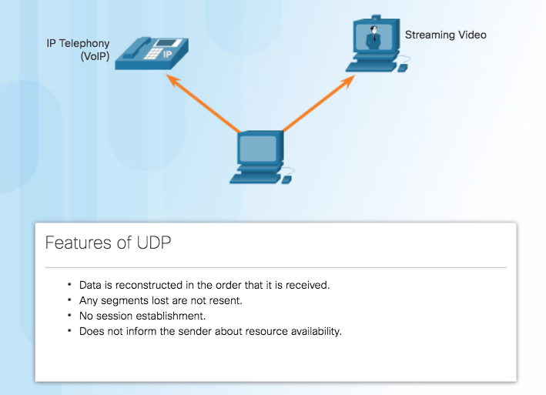
TCP and UDP Overview UDP Features
Notes:
9.1 – Transport Layer Protocols
9.1.2 – TCP and UDP Overview
9.1.2.3 – UDP Features

Slide 16
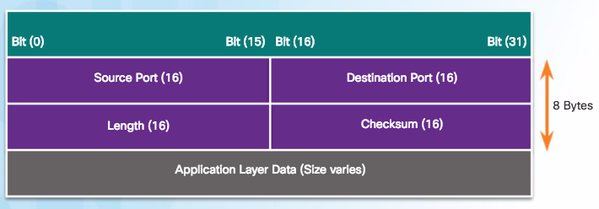
TCP and UDP Overview UDP Header
UDP is a stateless protocol – no tracking
Reliability handled by application
Notes:
9.1 – Transport Layer Protocols
9.1.2 – TCP and UDP Overview
9.1.2.4 – UDP Header

Slide 17
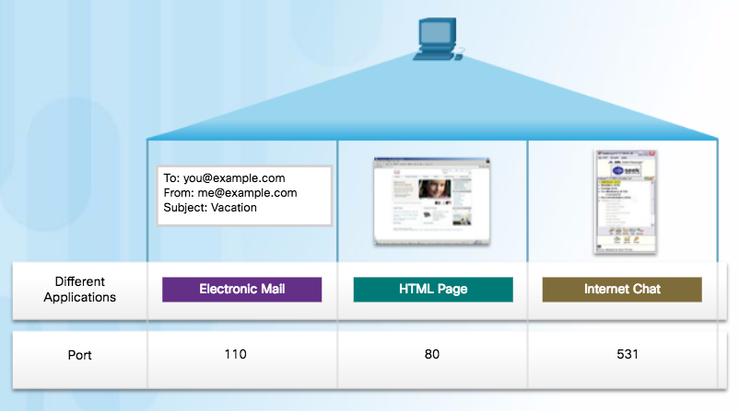
TCP and UDP Overview Multiple Separate Communications
Users expect to simultaneously receive and send email, view websites and make a VoIP phone call
TCP and UDP manage multiple conversations by using unique identifiers called port numbers
Notes:
9.1 – Transport Layer Protocols
9.1.2 – TCP and UDP Overview
9.1.2.5 – Multiple Separate Communications

Slide 18
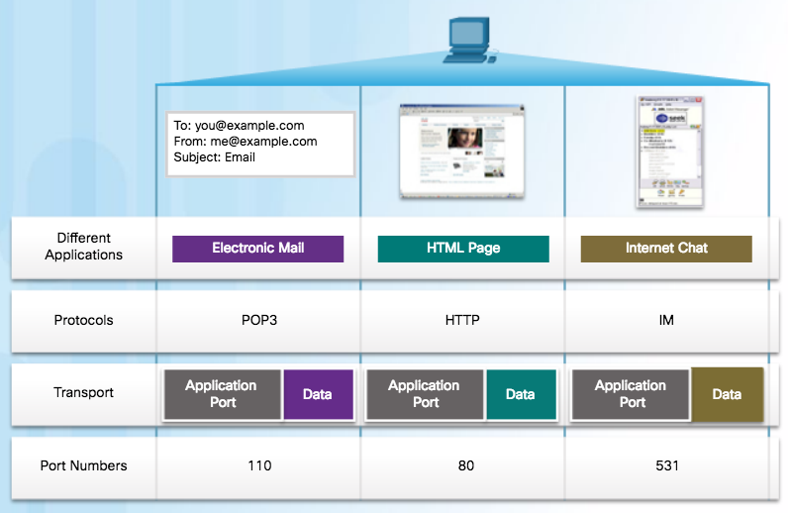
TCP and UDP Overview Port Numbers
Source Port
Originating application port that is dynamically generated by sending device
Example: Each separate HTTP conversation is tracked based on the source ports.
Destination Port
Tell the destination what service is being requested
Example: Port 80 web services are being requested
Notes:
9.1 – Transport Layer Protocols
9.1.2 – TCP and UDP Overview
9.1.2.6 – Port Numbers

Slide 19
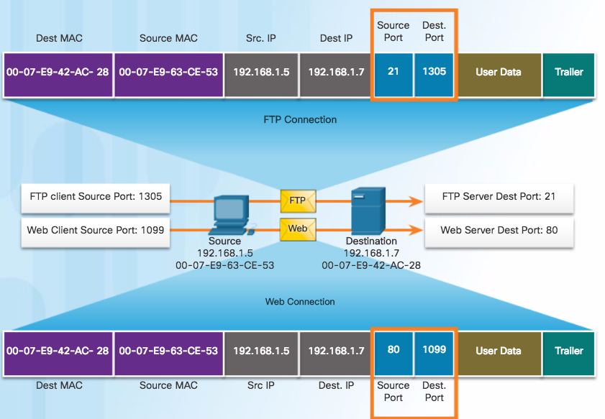
TCP and UDP Overview Socket Pairs
Source and destination port placed in segment
Segments encapsulated in IP packet
IP and port number = socket
Example: 192.168.1.7:80
Sockets enable multiple processes to be distinguished
Source port acts as a return address
Notes:
9.1 – Transport Layer Protocols
9.1.2 – TCP and UDP Overview
9.1.2.7 – Socket Pairs

Slide 20
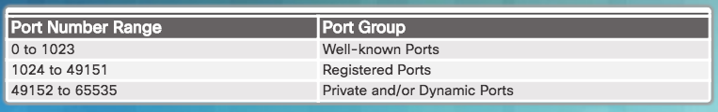
TCP and UDP Overview Port Number Groups
Well-known Ports (Numbers 0 to 1023) - These numbers are reserved for services and applications.
Registered Ports (Numbers 1024 to 49151) - These port numbers are assigned by IANA to a requesting entity to use with specific processes or applications.
Dynamic or Private Ports (Numbers 49152 to 65535) - Usually assigned dynamically by the client’s OS and used to identify the client application during communication.
Notes:
9.1 – Transport Layer Protocols
9.1.2 – TCP and UDP Overview
9.1.2.8 – Port Number Groups

Slide 21
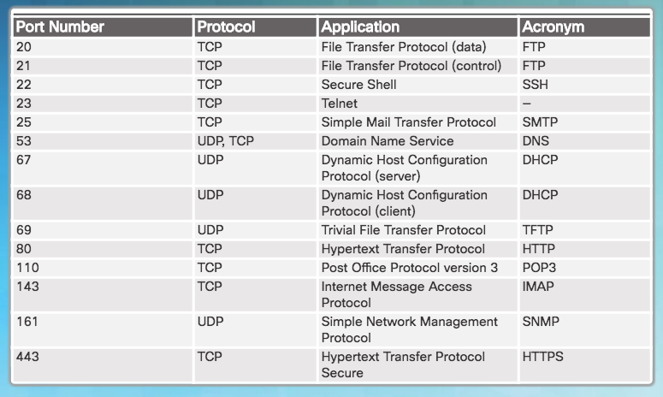
TCP and UDP Overview Port Number Groups (Cont.)
Well Known Port Numbers
Notes:
9.1 – Transport Layer Protocols
9.1.2 – TCP and UDP Overview
9.1.2.8 – Port Number Groups

Slide 22
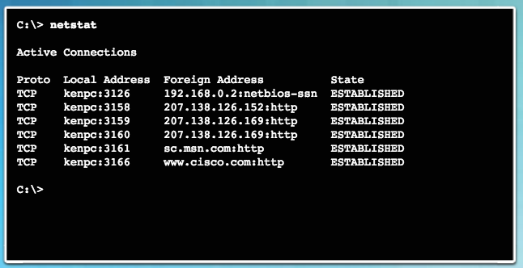
TCP and UDP Overview The netstat Command
Network utility that can be used to verify connections
By default, will attempt to resolve IP addresses to domain names and port numbers to well-known applications
-n option used to display IPs and ports in numerical form
Notes:
9.1 – Transport Layer Protocols
9.1.2 – TCP and UDP Overview
9.1.2.9 – The netstat Command

Slide 23
9.2 TCP and UDP
Notes:
9 - Configure a Network Operating System
9.2 – Basic Device Configuration

Slide 24
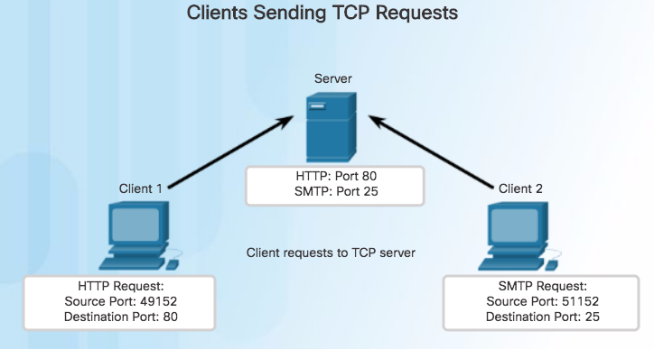
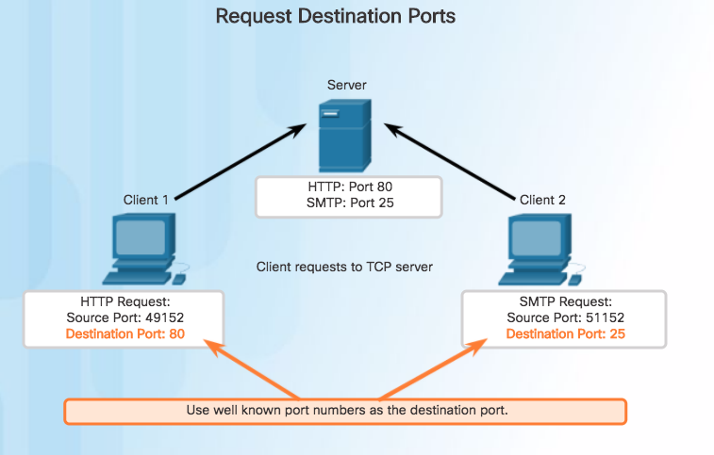
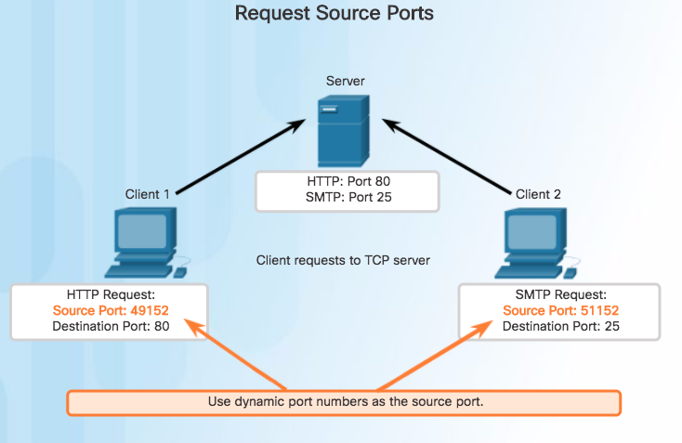
TCP Communication Process TCP Server Process
Notes:
9.2 – TCP and UDP
9.2.1 – TCP Communication Process
9.2.1.1 – TCP Server Process

Slide 25
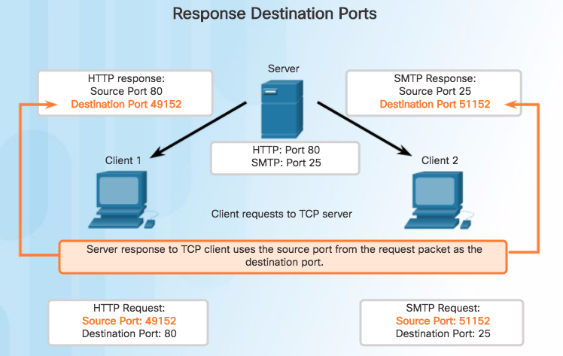
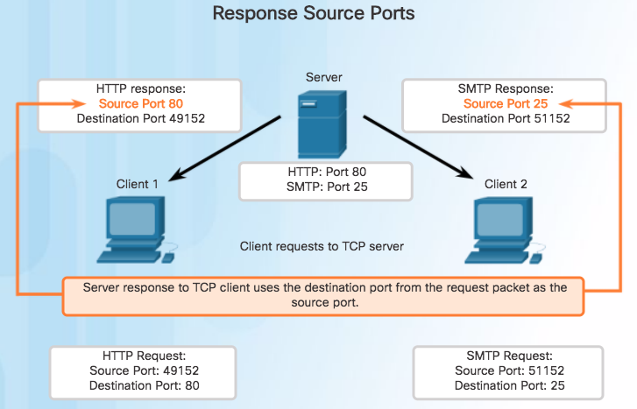
TCP Communication Process TCP Server Process (Cont.)
Notes:
9.2 – TCP and UDP
9.2.1 – TCP Communication Process
9.2.1.1 – TCP Server Process

Slide 26
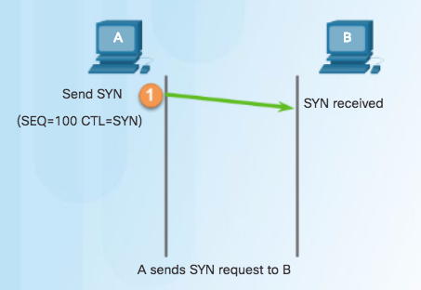
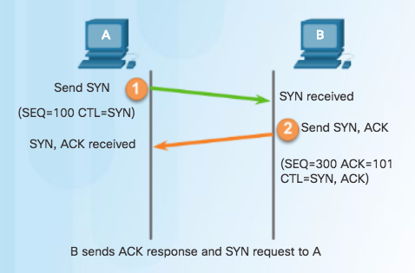
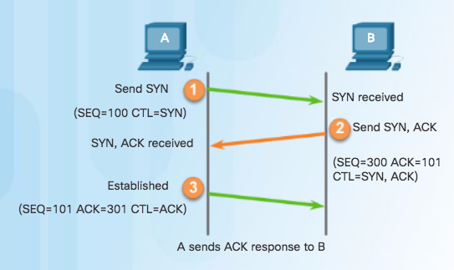
TCP Communication Process TCP Connection Establishment
Step 3 – Client acknowledges communication session with server.
Step 1 – Initiating client requests a session with server.
Step 2 – Server acknowledges and requests a session with client.
Notes:
9.2 – TCP and UDP
9.2.1 – TCP Communication Process
9.2.1.2 – TCP Connection Establishment

Slide 27
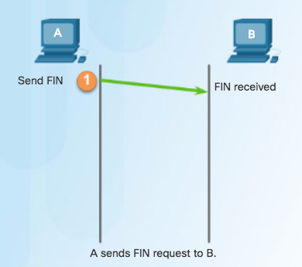
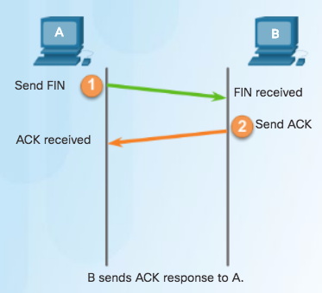
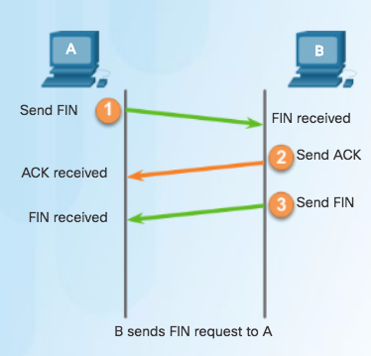
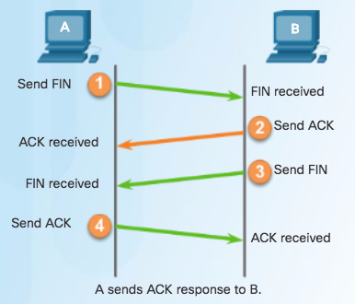
TCP Communication Process TCP Session Termination
To close a connection, the Finish (FIN) control flag must be set in the segment header.
To end each one-way TCP session, a two-way handshake, consisting of a FIN segment and an Acknowledgment (ACK) segment, is used.
To terminate a single conversation supported by TCP, four exchanges are needed to end both sessions.
Notes:
9.2 – TCP and UDP
9.2.1 – TCP Communication Process
9.2.1.3 – TCP Session Termination

Slide 28
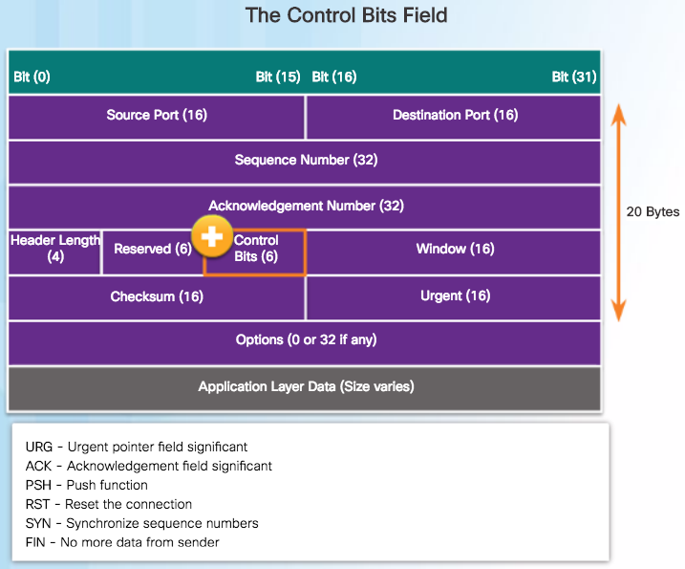
TCP Communication Process TCP Three-way Handshake Analysis
The three-way handshake:
Establishes that the destination device is present on the network.
Verifies that the destination device has an active service and is accepting requests on the destination port number that the initiating client intends to use.
Informs the destination device that the source client intends to establish a communication session on that port number.
The six bits in the Control Bits field of the TCP segment header are also known as flags.
RST flag is used to reset a connection when an error or timeout occurs
Notes:
9.2 – TCP and UDP
9.2.1 – TCP Communication Process
9.2.1.4 – TCP Three-way Handshake Analysis

Slide 29
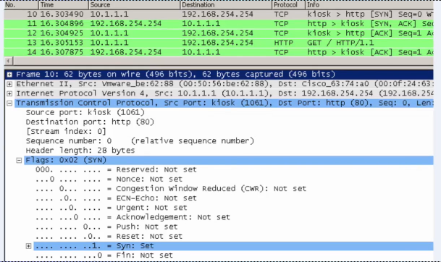
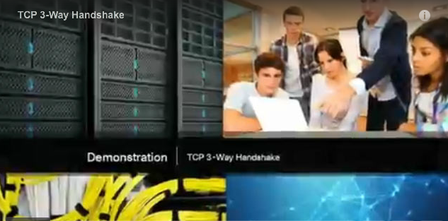
TCP Communication Process Video Demonstration - TCP 3-Way Handshake
SYN
SYN, ACK
ACK
Notes:
9.2 – TCP and UDP
9.2.1 – TCP Communication Process
9.2.1.5 – Video Demonstration - TCP 3-Way Handshake

Slide 30
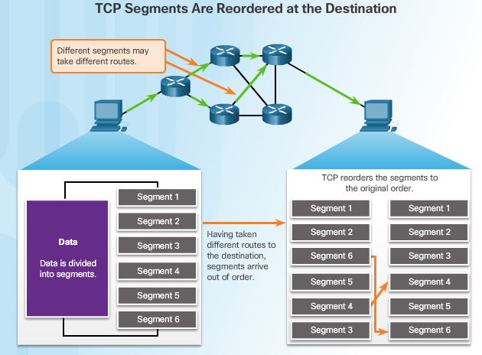
Reliability and Flow Control TCP Reliability – Ordered Delivery
Sequence numbers are assigned in the header of each packet.
Represents the first data byte of the TCP segment.
During session setup, an initial sequence number (ISN) is set - represents the starting value of the bytes.
As data is transmitted during the session, the sequence number is incremented by the number of bytes that have been transmitted.
Missing segments can then be identified.
Notes:
9.2 – TCP and UDP
9.2.2 – Reliability and Flow Control
9.2.2.1 – TCP Reliability – Ordered Delivery

Slide 31
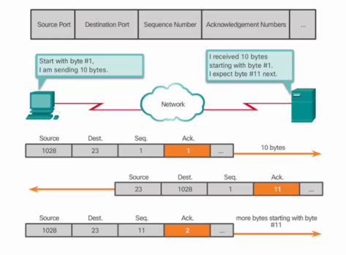
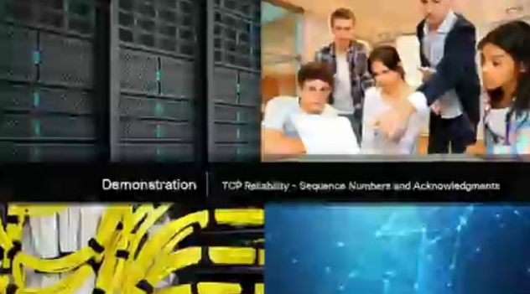
Reliability and Flow Control Video Demonstration - TCP Reliability – Sequence Numbers and Acknowledgments
Notes:
9.2 – TCP and UDP
9.2.2 – Reliability and Flow Control
9.2.2.2 – Video Demonstration – TCP Reliability – Sequence Numbers and Acknowledgments

Slide 32
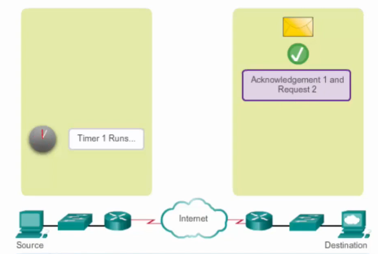
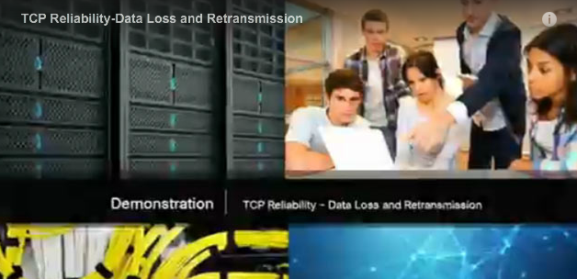
Reliability and Flow Control Video Demonstration – Data Loss and Retransmission
Notes:
9.2 – TCP and UDP
9.2.2 – Reliability and Flow Control
9.2.2.3 – Video Demonstration – Data Loss and Retransmission

Slide 33
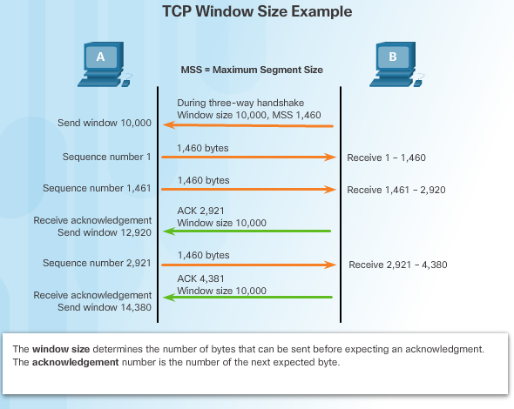
Reliability and Flow Control TCP Flow Control – Window Size and Acknowledgments
In the figure, the source is transmitting 1,460 bytes of data within each segment.
Window size agreed on during 3-way handshake.
Typically, PC B will not wait for 10,000 bytes before sending an acknowledgment.
PC A can adjust its send window as it receives acknowledgments from PC B.
Notes:
9.2 – TCP and UDP
9.2.2 – Reliability and Flow Control
9.2.2.4 – TCP Flow Control – Window Size and Acknowledgments

Slide 34
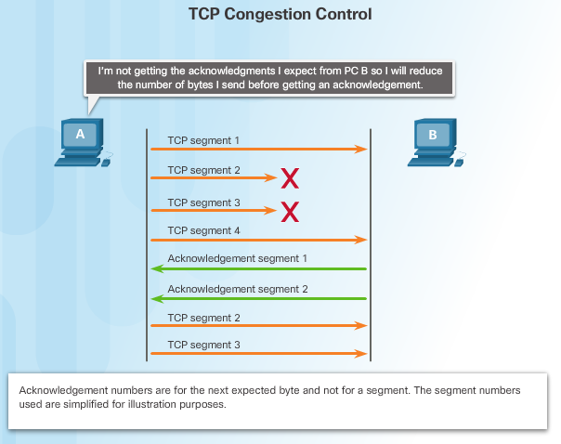
Reliability and Flow Control TCP Flow Control – Congestion Avoidance
Congestion causes retransmission of lost TCP segments
Retransmission of segments can make the congestion worse
To avoid and control congestion, TCP employs several congestion handling mechanisms, timers, and algorithms
Example: Reduce the number of bytes it sends before receiving an acknowledgment
Notes:
9.2 – TCP and UDP
9.2.2 – Reliability and Flow Control
9.2.2.5 – TCP Flow Control – Congestion Avoidance

Slide 35
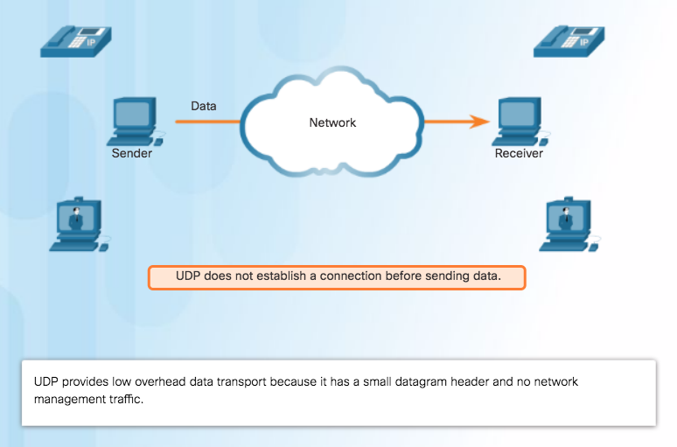
UDP Communication UDP Low Overhead versus Reliability
UDP not connection-oriented
No retransmission, sequencing, and flow control
Functions not provided by the transport layer implemented elsewhere
Notes:
9.2 – TCP and UDP
9.2.3 – UDP Communication
9.2.3.1 – UDP Low Overhead versus Reliability

Slide 36
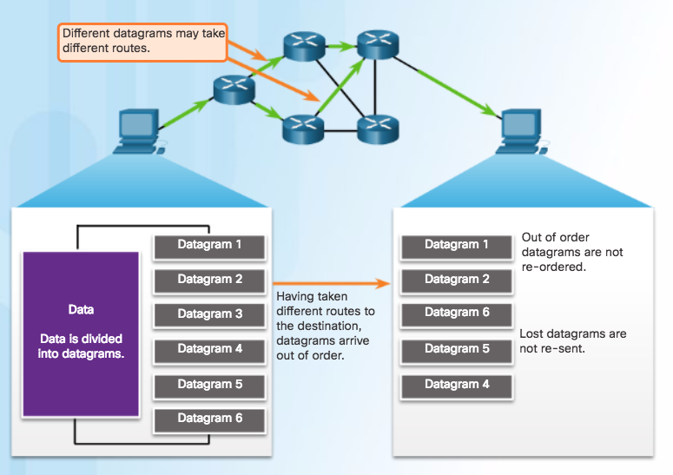
UDP Communication UDP Datagram Reassembly
UDP reassembles data in order received and forwards to application
Application must identify the proper sequence
UDP: Connectionless and Unreliable
Notes:
9.2 – TCP and UDP
9.2.3 – UDP Communication
9.2.3.2 – UDP Datagram Reassembly

Slide 37
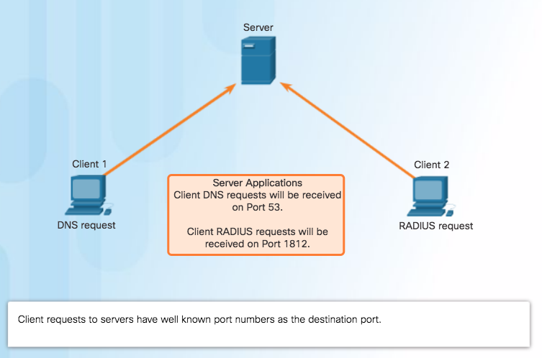
UDP Communication UDP Server Processes and Requests
Note: The Remote Authentication Dial-in User Service (RADIUS) server shown in the figure provides authentication, authorization, and accounting services to manage user access.
Notes:
9.2 – TCP and UDP
9.2.3 – UDP Communication
9.2.3.3 – UDP Server Processes and Requests

Slide 38
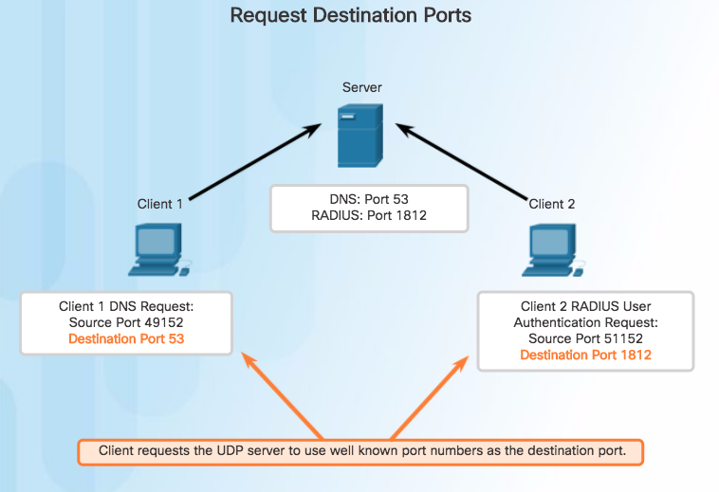
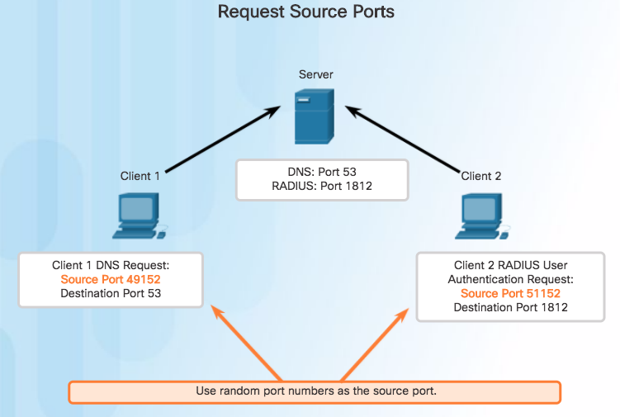
UDP Communication UDP Client Processes
Clients Sending UDP Requests
Notes:
9.2 – TCP and UDP
9.2.3 – UDP Communication
9.2.3.4 – UDP Client Processes

Slide 39


UDP Communication UDP Client Processes (Cont.)
Clients Sending UDP Requests
Notes:
9.2 – TCP and UDP
9.2.3 – UDP Communication
9.2.3.4 – UDP Client Processes

Slide 40

TCP or UDP Applications that use TCP
TCP frees applications from having to manage reliability
Notes:
9.2 – TCP and UDP
9.2.4 – TCP or UDP
9.2.4.1– Applications that use TCP

Slide 41

TCP or UDP Applications that use UDP
Three types of applications best suited for UDP:
Live video and multimedia
Simple request and reply
Handle reliability themselves
Notes:
9.2 – TCP and UDP
9.2.4 – TCP or UDP
9.2.4.2 – Applications that use UDP

Slide 42
9.3 Chapter Summary
Notes:
9 – Transport Layer
9.3 – Summary

Slide 43
Conclusion Chapter 9: Transport Layer
Explain how transport layer protocols and services support communications across data networks.
Compare the operations of transport layer protocols in supporting end-to-end communication.
Notes:
9.3 – Summary
9.3.1 – Conclusion
9.3.1.3 – Chapter 9: Transport Layer

Slide 44
Section 9.1 New Terms and Commands
port number multiplexing | Transmission Control Protocol (TCP) User Datagram Protocol (UDP) | connection-oriented stateful socket
Notes:
New Terms and Commands

Slide 45
Section 9.2 New Terms and Commands
three-way handshake initial sequence port number (ISN) | acknowledgment selective acknowledgment (SACK) window size
Notes:
New Terms and Commands

